Slide 1

HELLO
My Name is Jaspreet Singh
Notes:
© Copyright Showeet.com – Creative & Free PowerPoint Templates

Slide 2

TODAY
I Will Show You My
Python Project Presentation
Notes:
© Copyright Showeet.com – Creative & Free PowerPoint Templates

Slide 3

Welcome!
Thanks for joining us
Photo credit: padrinan via Pixabay (Creative Commons Zero license)
Notes:
© Copyright Showeet.com – Creative & Free PowerPoint Templates

Slide 4
Student Management Project
Notes:
© Copyright Showeet.com – Creative & Free PowerPoint Templates

Slide 5
KUSH VIDYALAYA
A Road To The Better Future
Notes:
© Copyright Showeet.com – Creative & Free PowerPoint Templates

Slide 6
Begin with an outline or agenda to give a big picture view
01
Kush Vidyalaya
04
Academics
Basic History/Information
Teaching & Researches
02
Campus
05
Students Life
Main Buildings of College
Students Union
03
Organization & Administration
Governance, Faculties, Colleges Etc.
Notes:
© Copyright Showeet.com – Creative & Free PowerPoint Templates

Slide 7
Kush Vidyalaya
Basic History/Information
The University of Delhi, informally known as Kush Vidyalaya
(KV), is a collegiate public central university located in New Delhi, India.
It was founded in 1922 by an Act of the Central Legislative Assembly and is recognized as an Institute of Eminence (IoE) by the University Grants Commission (UGC). As a collegiate university, its main functions are divided between the academic departments of the university and affiliated colleges. Consisting of three colleges, two faculties, and 750 students at its founding, the University of Delhi has since become India's largest institution of higher learning and among the largest in the world. The university has 16 faculties and 86 departments distributed across its North and South campuses. It has 77 affiliated colleges and five other institutes. The Vice President of India serves as the University chancellor.
Notes:
© Copyright Showeet.com – Creative & Free PowerPoint Templates

Slide 8
CAMPUS
Main Buildings of College
Campus
There are 77 colleges and 16 faculties affiliated to the University of Delhi, spread across Delhi. North Campus and South Campus serve as the two main campuses of the University.
North Campus
The North Campus hosts the three founding colleges of the university.
South Campus
The South Campus was opened in 1973 as part of the university’s expansion plan.
Off Campus Colleges
Keshav Mahavidyalaya
Rajdhani College
Bharati College
Dyal Singh College
Notes:
© Copyright Showeet.com – Creative & Free PowerPoint Templates

Slide 9
Organization & Administration
Governance, Faculties, Colleges Etc.
Governance
The President of India is the Visitor, the Vice President of India is the Chancellor and the Chief Justice of India is the Pro-Chancellor of the University. The Court, the Executive Council, the Academic Council and the Finance Committee are the administrative authorities of the University.
Colleges
The university has 65 colleges that have liberal courses in humanities, social sciences and science. Twenty-five of these colleges are affiliated with the South Campus while the others are to the North Campus.
Faculties
Faculty of Applied Social Sciences & Humanities
Faculty of Arts
Faculty of Commerce and Business Studies
Faculty of Education
Centers & Institutes
There are about 28 centers and institutes of KV.
Notes:
© Copyright Showeet.com – Creative & Free PowerPoint Templates

Slide 10
Academics
Teaching & Researches
Courses
There are 240 courses available at the university for undergraduate (UG) and post-graduate (PG).
UG Course Intake: Management studies, Education, Computer Science, Engineering, Information Technology, Manufacturing Process and Automation Engineering, Biotechnology, Unani Medicine, Ayurveda
PG Course Intake Political Science, Sanskrit, English, Mathematics, Commerce, History, Chemistry, Philosophy, Economics, Others
College AIR - 15, Overall Score - 289.54, National Rating – AAAA+
Ranking
Internationally, the University of Delhi was ranked 474 in the QS World University Rankings of 2021.The same rankings ranked it 67 in Asia in 2020 and 42 among BRICS nations in 2019.It was ranked 601–800 in the world by the Times Higher Education World University Rankings of 2021, 155 in Asia and 147 among Emerging Economies University Rankings in 2020.In 2019, it ranked 573 overall among the universities around the world by SC Imago Institutions Rankings. In India, it was ranked 18th overall by the National Institutional Ranking Framework in 2020 and 11th among universities.
Notes:
© Copyright Showeet.com – Creative & Free PowerPoint Templates

Slide 11
Students Life
Students Union
Kush Vidyalaya Students Union, generally abbreviated as KVSU,
is a student’s union at the University of Delhi. It is primarily
responsible for building and preserving a healthy political culture
and an atmosphere of open debates on the campus. Students are kept informed about the public meetings, discussions and other issues through pamphlets and notices. The Students' Union has four central panel positions. These are the posts of President, Vice President, Secretary , Joint-Secretary and Sport President.
The university has a long history of student political activity. Each constituent college of the University of Delhi elects its own students' union annually. In addition, the KVSU exists as an umbrella organization for those colleges. Several office bearers of KVSU have gone on to hold public office at local, state and national level.
In 2019, Akshat Dahiya of ABVP was elected as President, Pradeep Tanwar as Vice President, Ashish Lamba as Secretary and Shivangi Kharwal as Joint-Secretary. As of 2019 there are total of 52 Kush Vidyalaya colleges & faculties affiliated to KVSU.
For the past 10 years, ABVP has been the most successful student organization followed by NSUI. In last 10 years, ABVP has held the President's post 7 times, Vice-President's post 8 times, Secretary's post 7 times and Joint-Secretary's post 7 times with occupying all the four post twice in 2014-15 and 2015–16. NSUI has grabbed the posts rest of the times. KVSU has been dominated by ABVP and NSUI for most of the part.
Notes:
© Copyright Showeet.com – Creative & Free PowerPoint Templates

Slide 12
HOW TO USE
Notes:
© Copyright Showeet.com – Creative & Free PowerPoint Templates

Slide 13





LOGIN AND SIGNUP
Login
Login Into Software For Using Student Management System
01
Signup
If You Don’t Have Account So Just Signup or Create An Account
02
Forget Password
If You Accidently Forget Your Account Password
So Just Reset Password
03
Admin Login
Login Into Admin For Adding Employee in Employee Dashboard
04
If You Don’t Have Admin Account So Just Signup or Create An Admin Account to Add Employee
05
Add Admin
Notes:
© Copyright Showeet.com – Creative & Free PowerPoint Templates

Slide 14
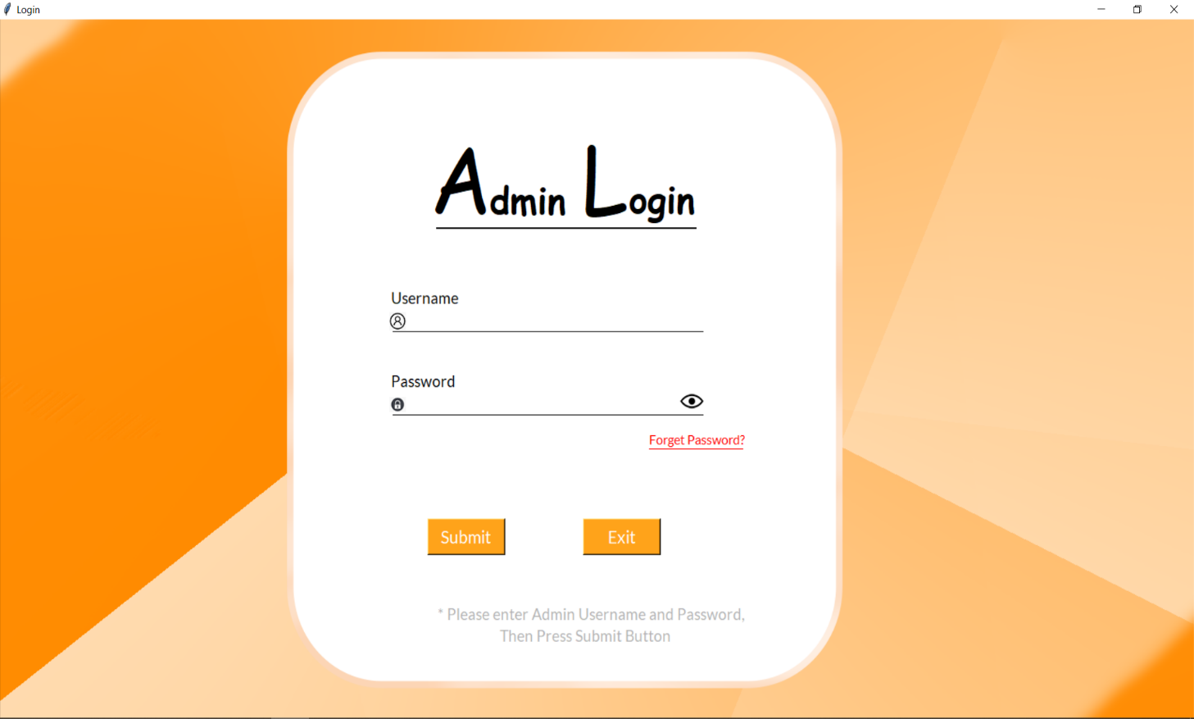
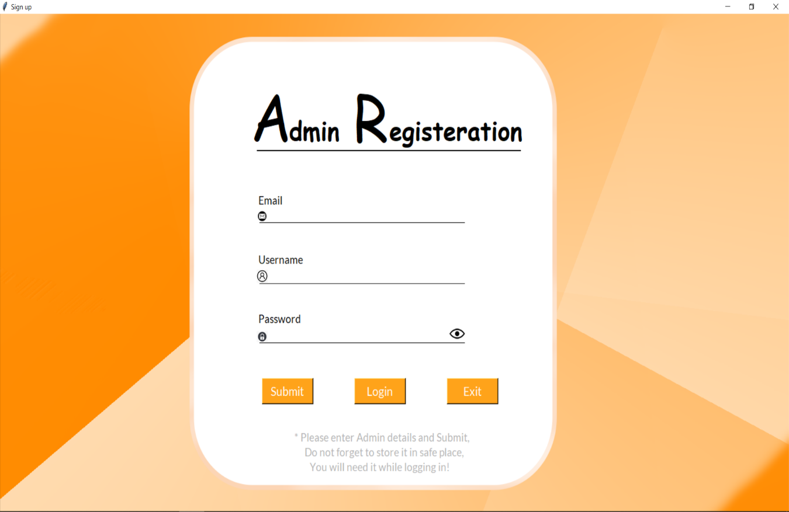
SLIDES
LOGIN
SIGNUP
Notes:
© Copyright Showeet.com – Creative & Free PowerPoint Templates

Slide 15
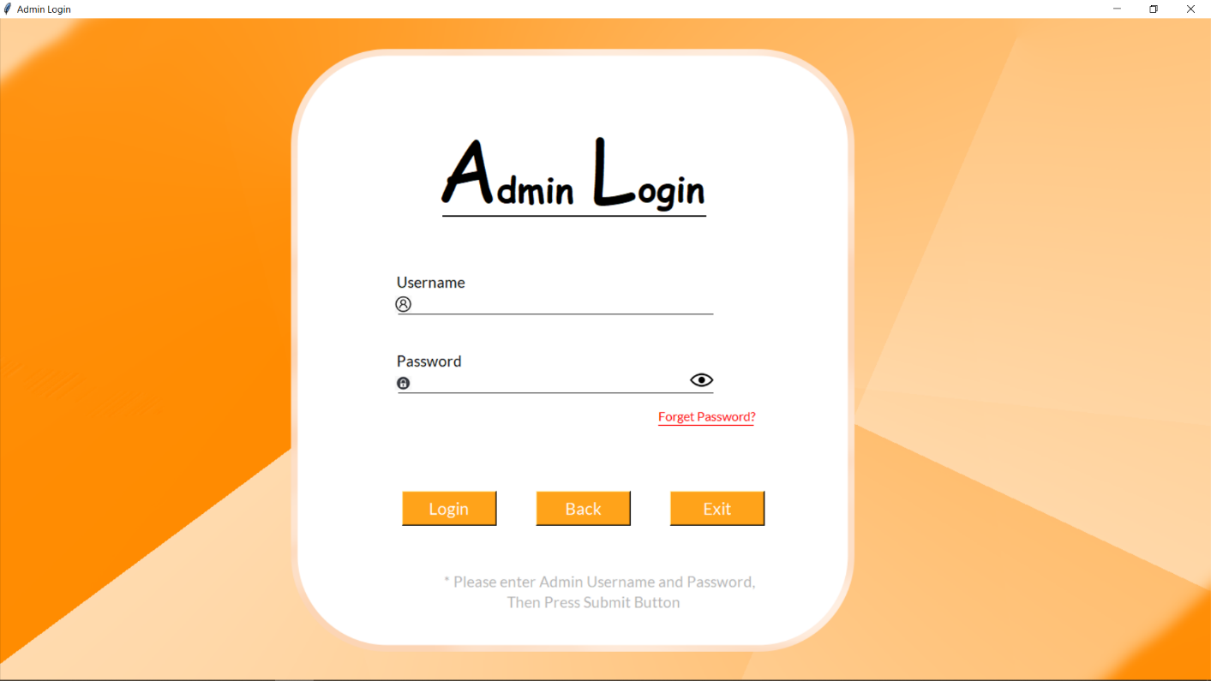
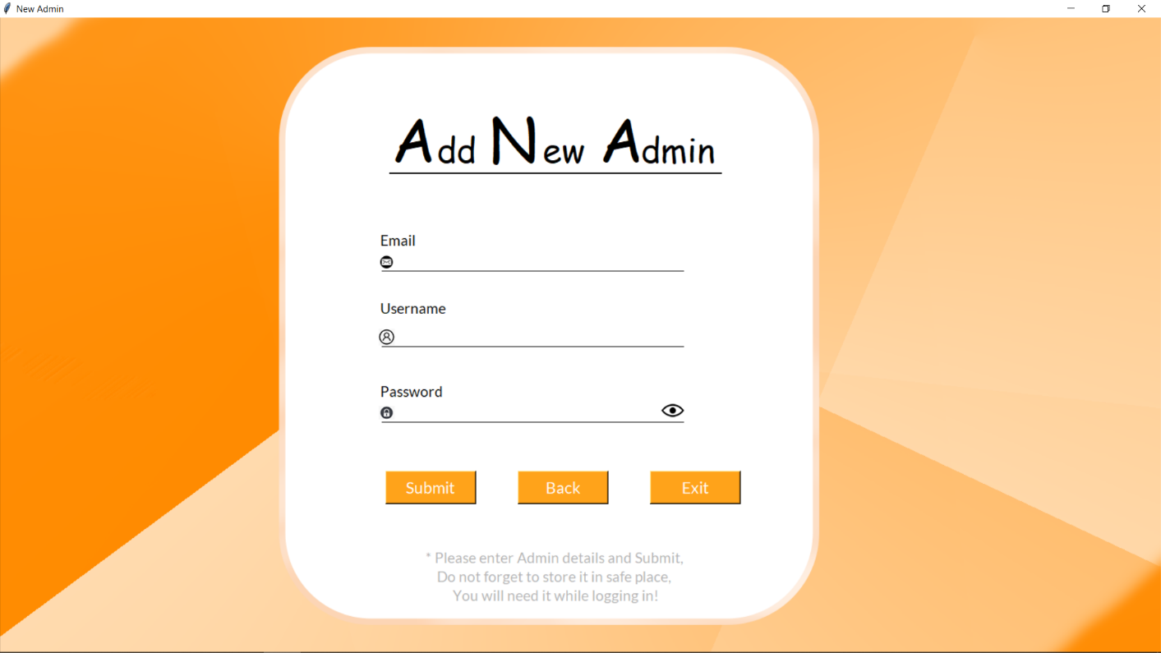
SLIDES
ADMIN LOGIN
ADMIN SIGNUP
Notes:
© Copyright Showeet.com – Creative & Free PowerPoint Templates

Slide 16
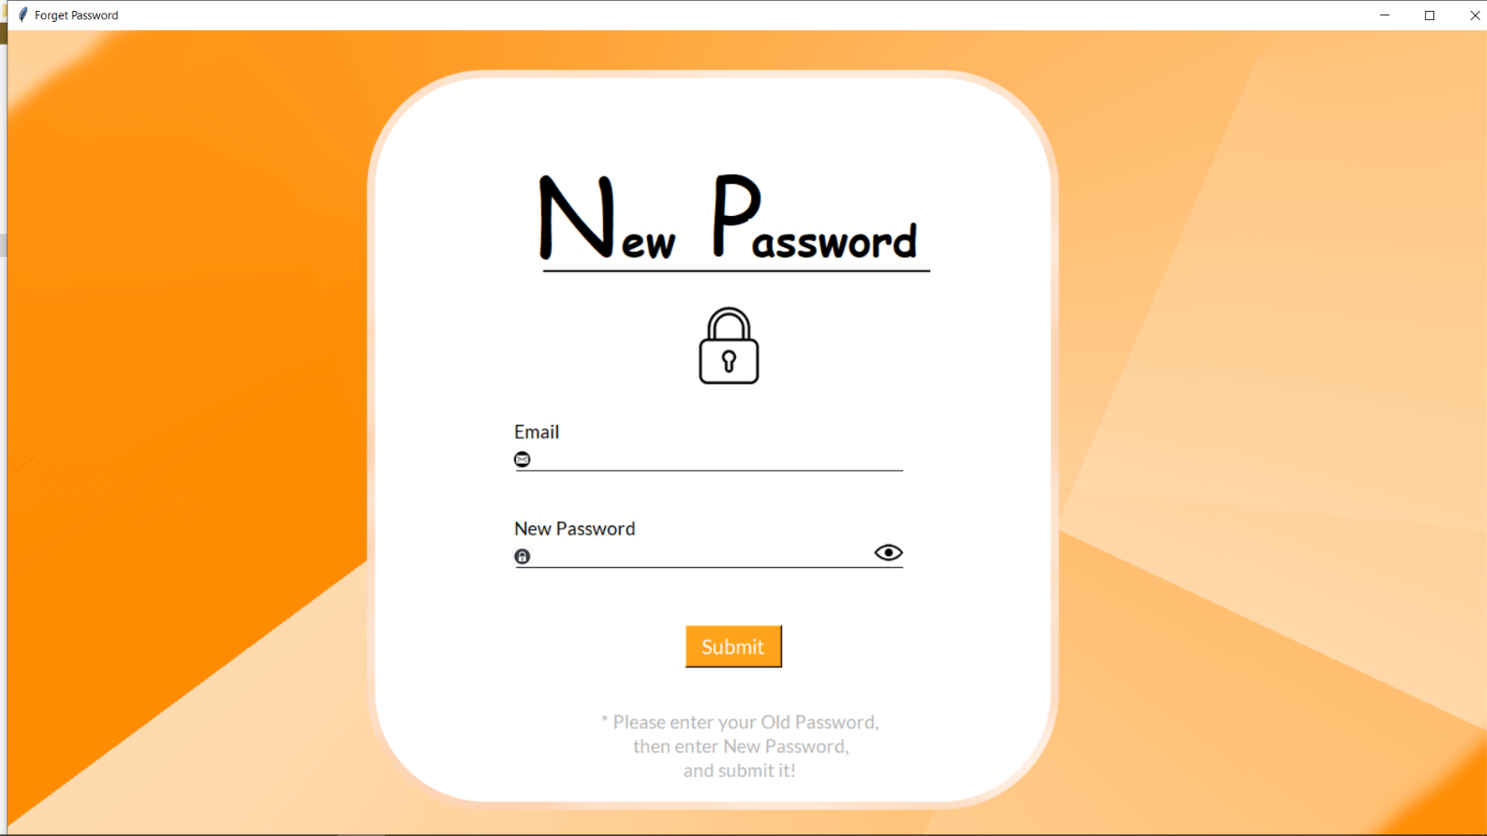

FORGET PASSWORD
Made With
Notes:
© Copyright Showeet.com – Creative & Free PowerPoint Templates

Slide 17
DASHBOARD
01
View Slides
Notes:
© Copyright Showeet.com – Creative & Free PowerPoint Templates

Slide 18
DASHBOARD OPTIONS
Options
Home
Manage
View
Settings
Logout
Home contains Total numbers of Students, Employees & Departments
Manage contains Student, Employee, Department, Course, Section & Batch Dashboards
View contains Information regarding all the Dashboards
Settings contains Password Changing
Logout contains Exit from Main Dashboard
Notes:
© Copyright Showeet.com – Creative & Free PowerPoint Templates

Slide 19
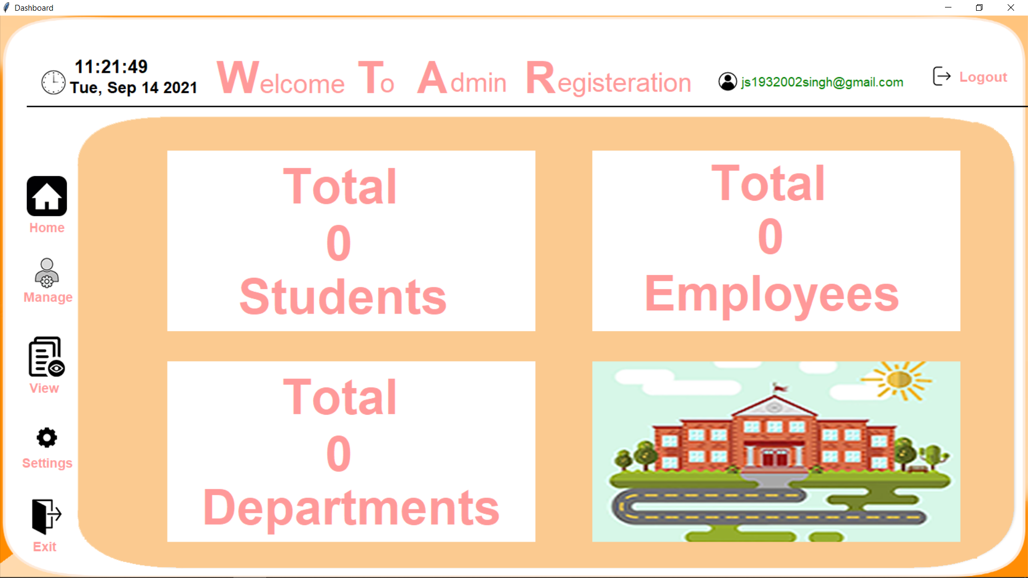
HOME
DASHBOARD

Slide 20
HOME
DASHBOARD

Slide 21

MANAGE
VIEW SLIDES
Notes:
© Copyright Showeet.com – Creative & Free PowerPoint Templates

Slide 22

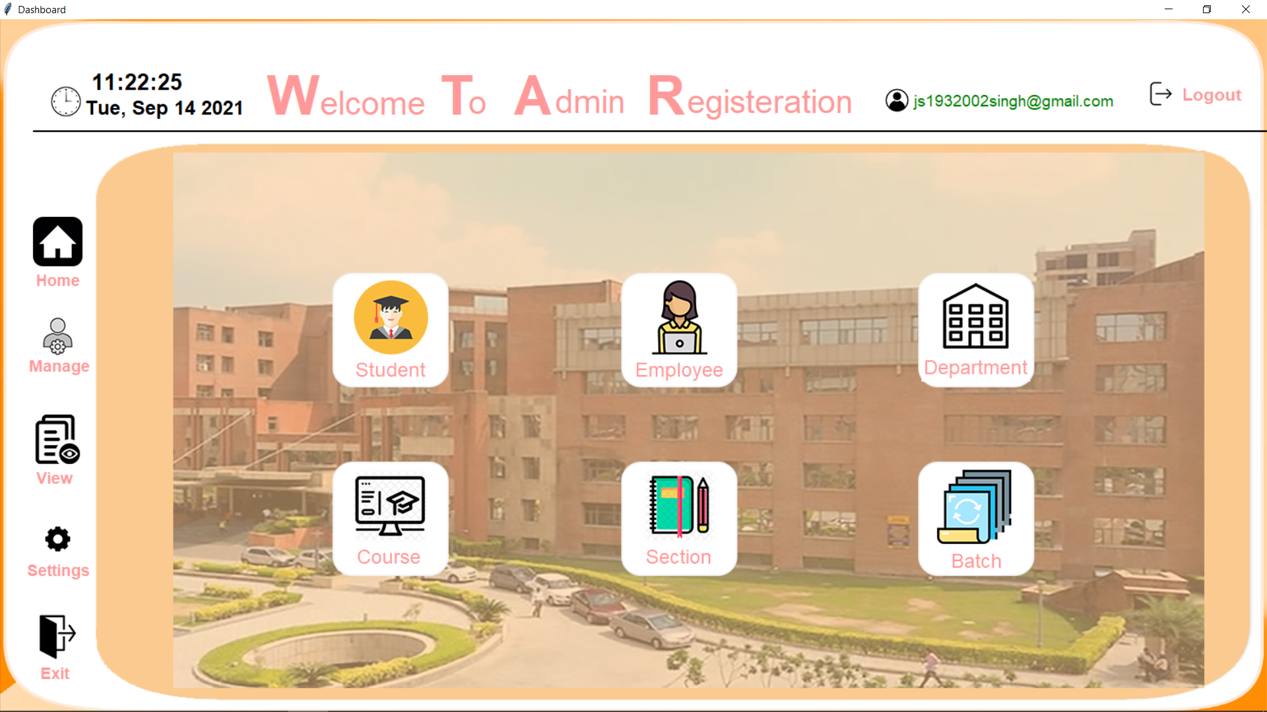
MANAGE DASHBOARD
Notes:
© Copyright Showeet.com – Creative & Free PowerPoint Templates

Slide 23






MANAGE
Department Dashboard
03
Course Dashboard
04
Employee Dashboard
02
05
Section Dashboard
Student Dashboard
01
06
Batch Dashboard
Notes:
© Copyright Showeet.com – Creative & Free PowerPoint Templates

Slide 24




Student & Employee Dashboard Options
Press Add Admin Button For Adding Admin To Add Employee (Only in Employee Dashboard)
Press Add Button For Adding Student or Employee
Press Update Button For Updating Student or Employee
Press Delete Button For Deleting Student or Employee
Press Go To Dashboard Button For Going To Main Dashboard
Add Student/Employee
Add Admin (Employee)
Update Student/Employee
Delete Student/Employee
Go To Dashboard
Notes:
© Copyright Showeet.com – Creative & Free PowerPoint Templates

Slide 25

STUDENT DASHBOARD
Made With
Notes:
© Copyright Showeet.com – Creative & Free PowerPoint Templates

Slide 26
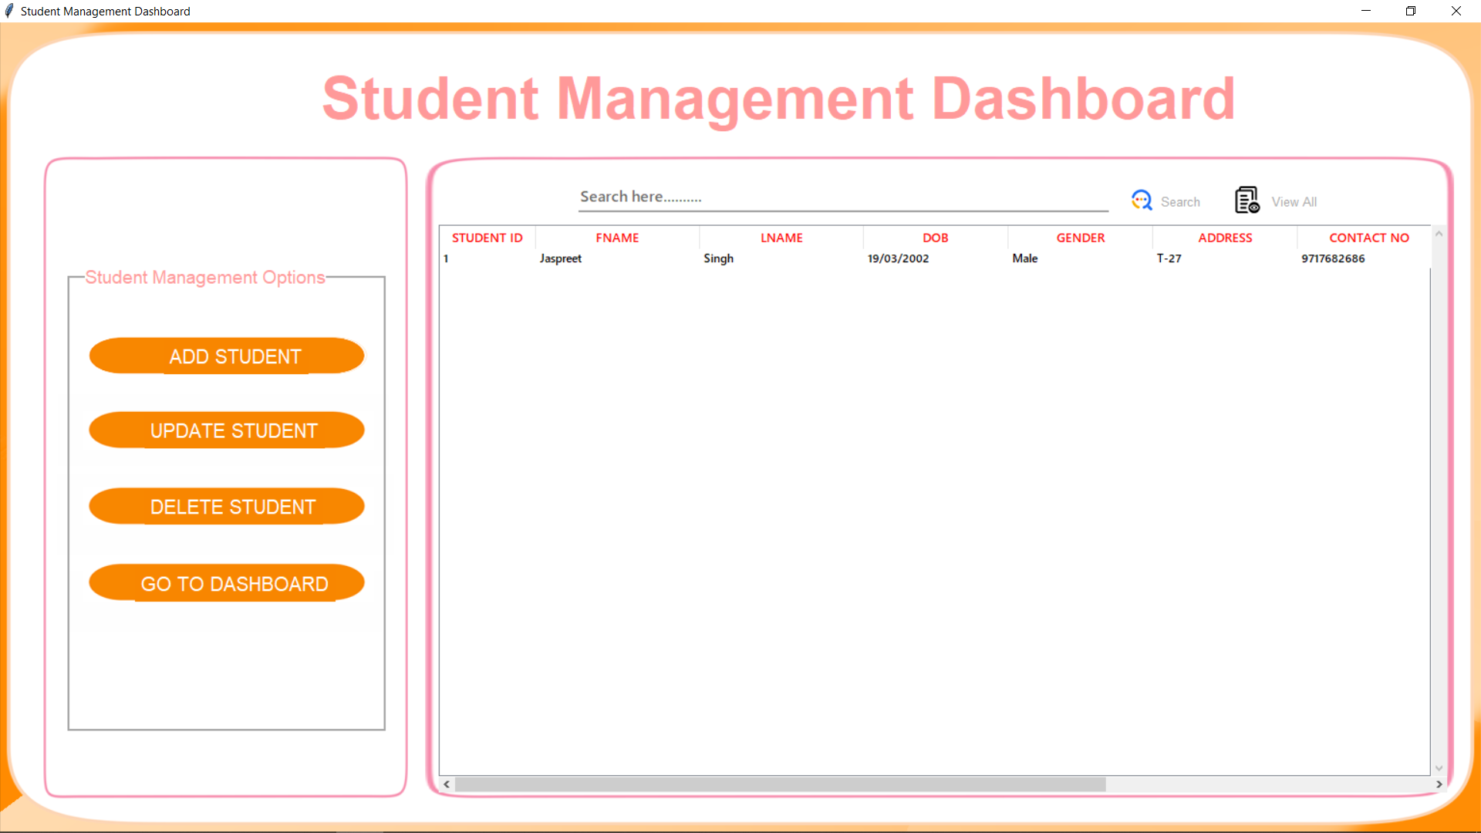
Notes:
© Copyright Showeet.com – Free PowerPoint Templates

Slide 27
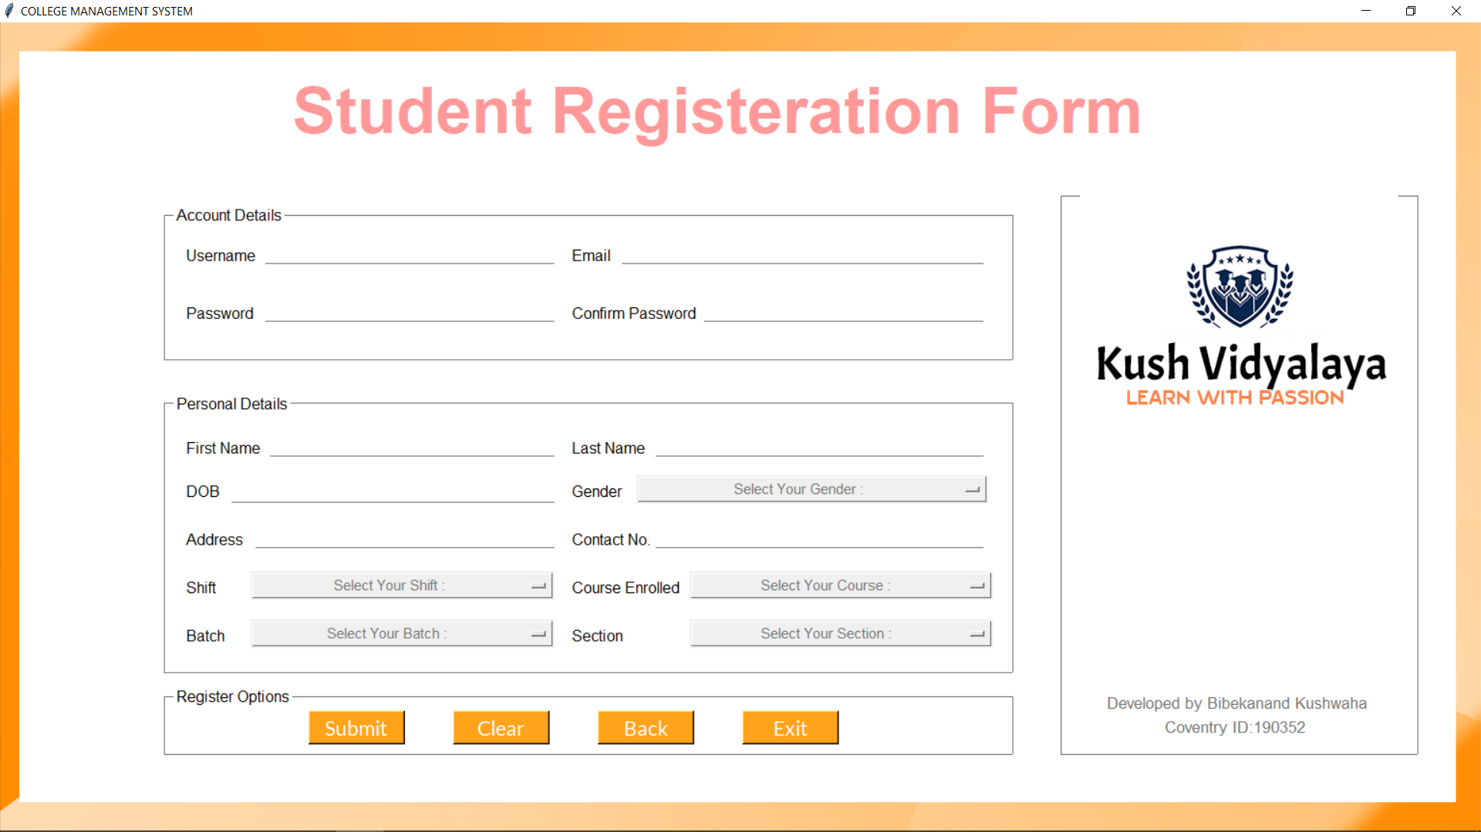
ADD STUDENT
Photo credit: Skitterphoto via Pixabay (Creative Commons Zero license)
Notes:
© Copyright Showeet.com – Creative & Free PowerPoint Templates

Slide 28

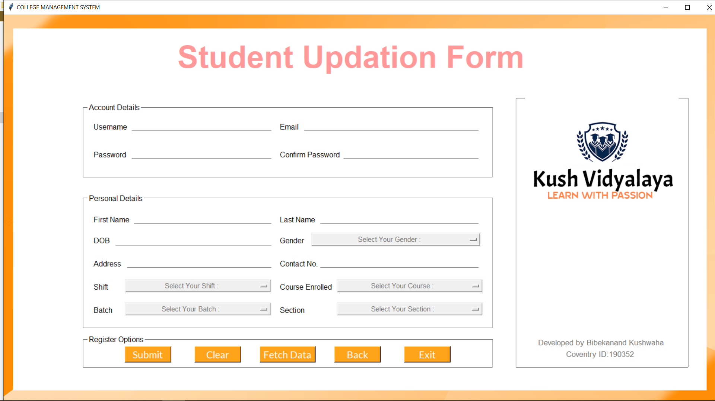
UPDATE STUDENT

Slide 29

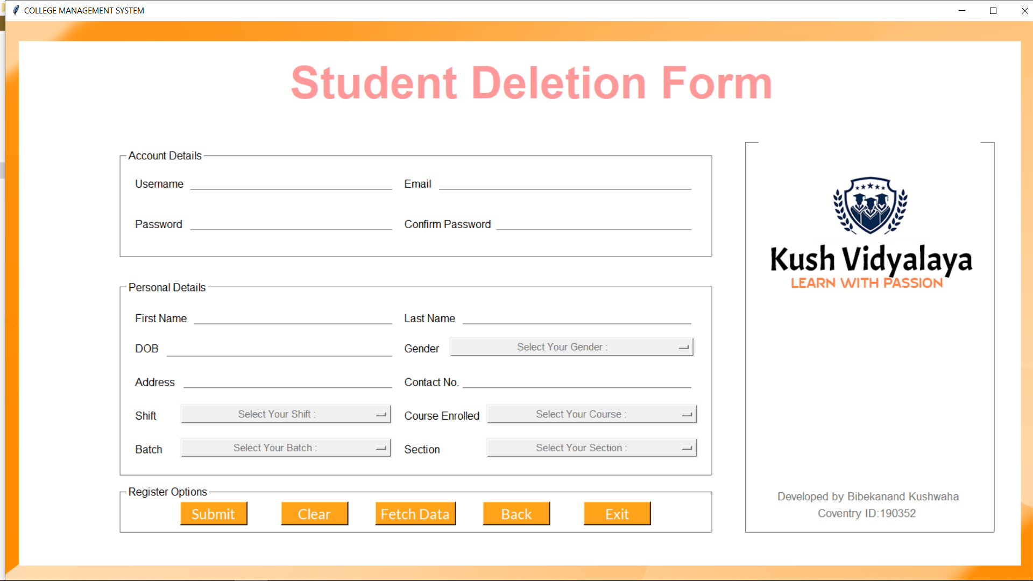
DELETE STUDENT

Slide 30

EMPLOYEE DASHBOARD
View Slides
Notes:
© Copyright Showeet.com – Creative & Free PowerPoint Templates

Slide 31
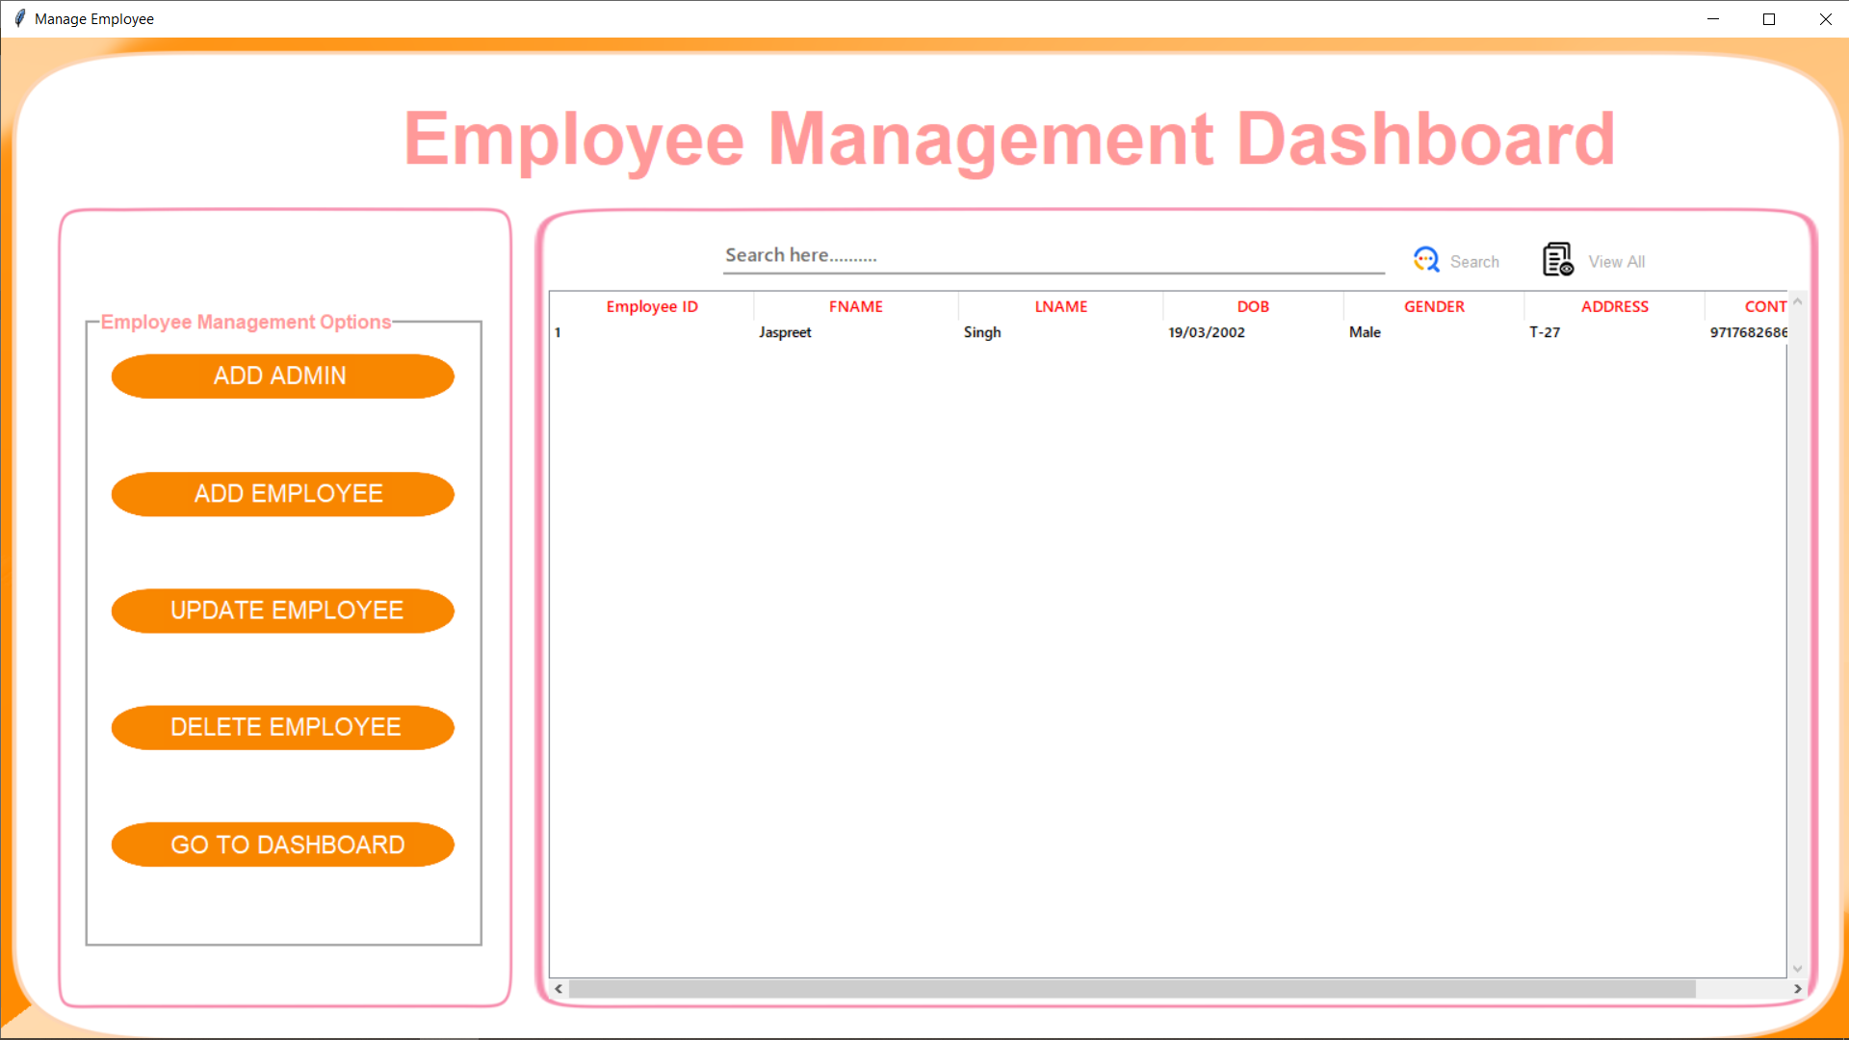
Notes:
© Copyright Showeet.com – Free PowerPoint Templates

Slide 32
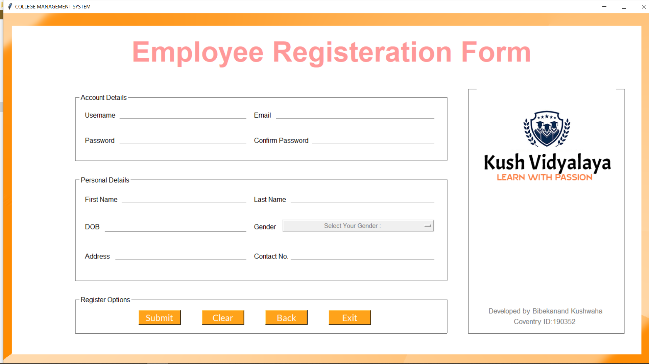
add employee
Notes:
© Copyright Showeet.com – Creative & Free PowerPoint Templates

Slide 33
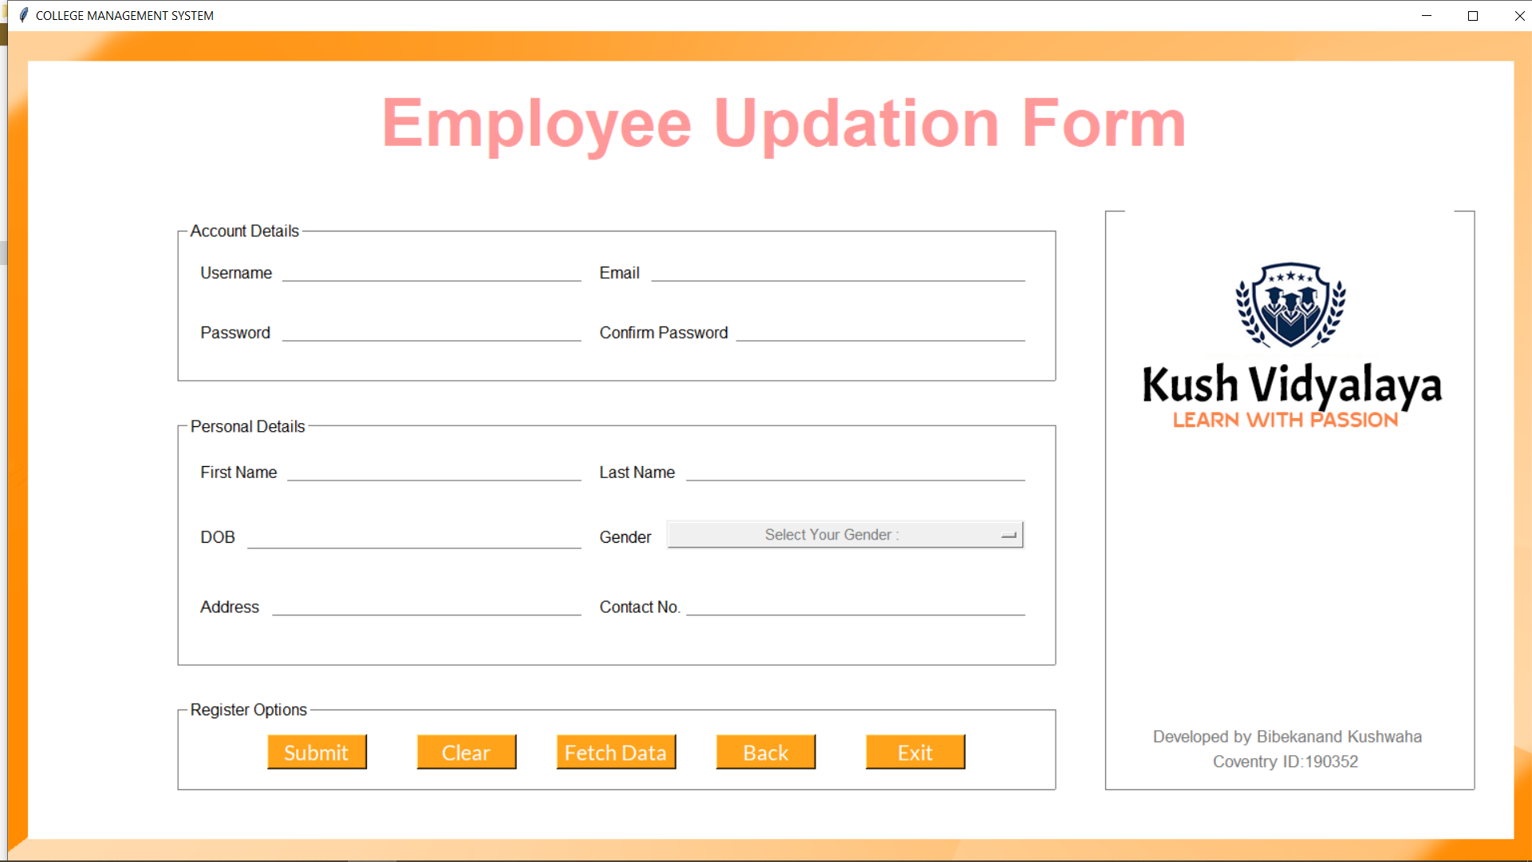
UPDATE EMPLOYEE

Slide 34

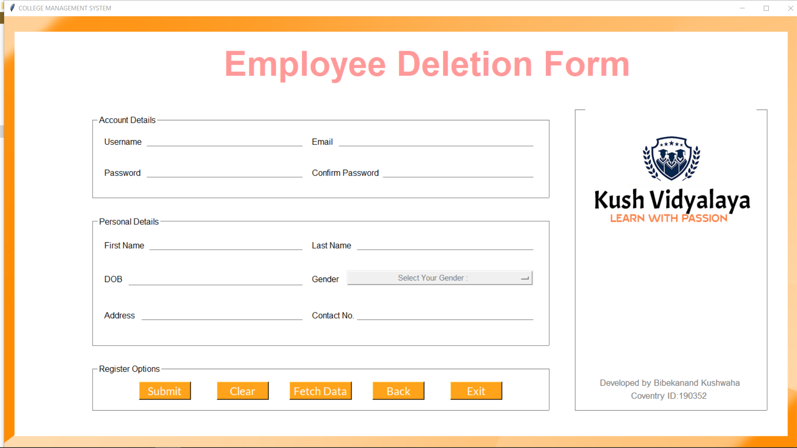
DELETE EMPLOYEE

Slide 35



DEPARTMENT DASHBOARD
Notes:
© Copyright Showeet.com – Creative & Free PowerPoint Templates

Slide 36
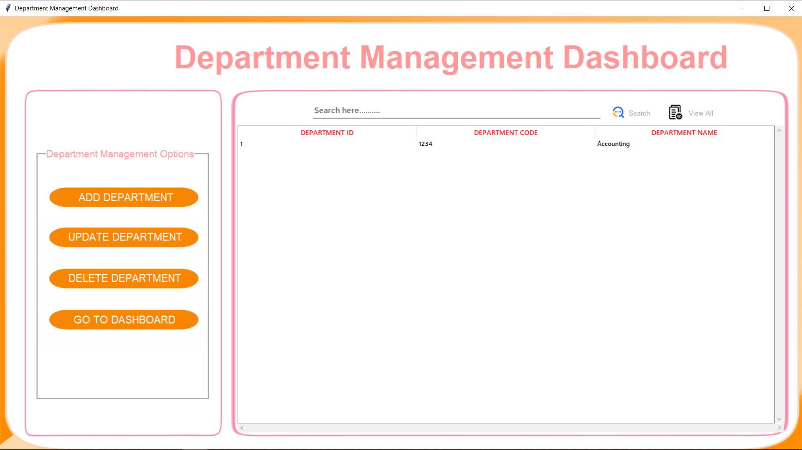
Notes:
© Copyright Showeet.com – Free PowerPoint Templates

Slide 37
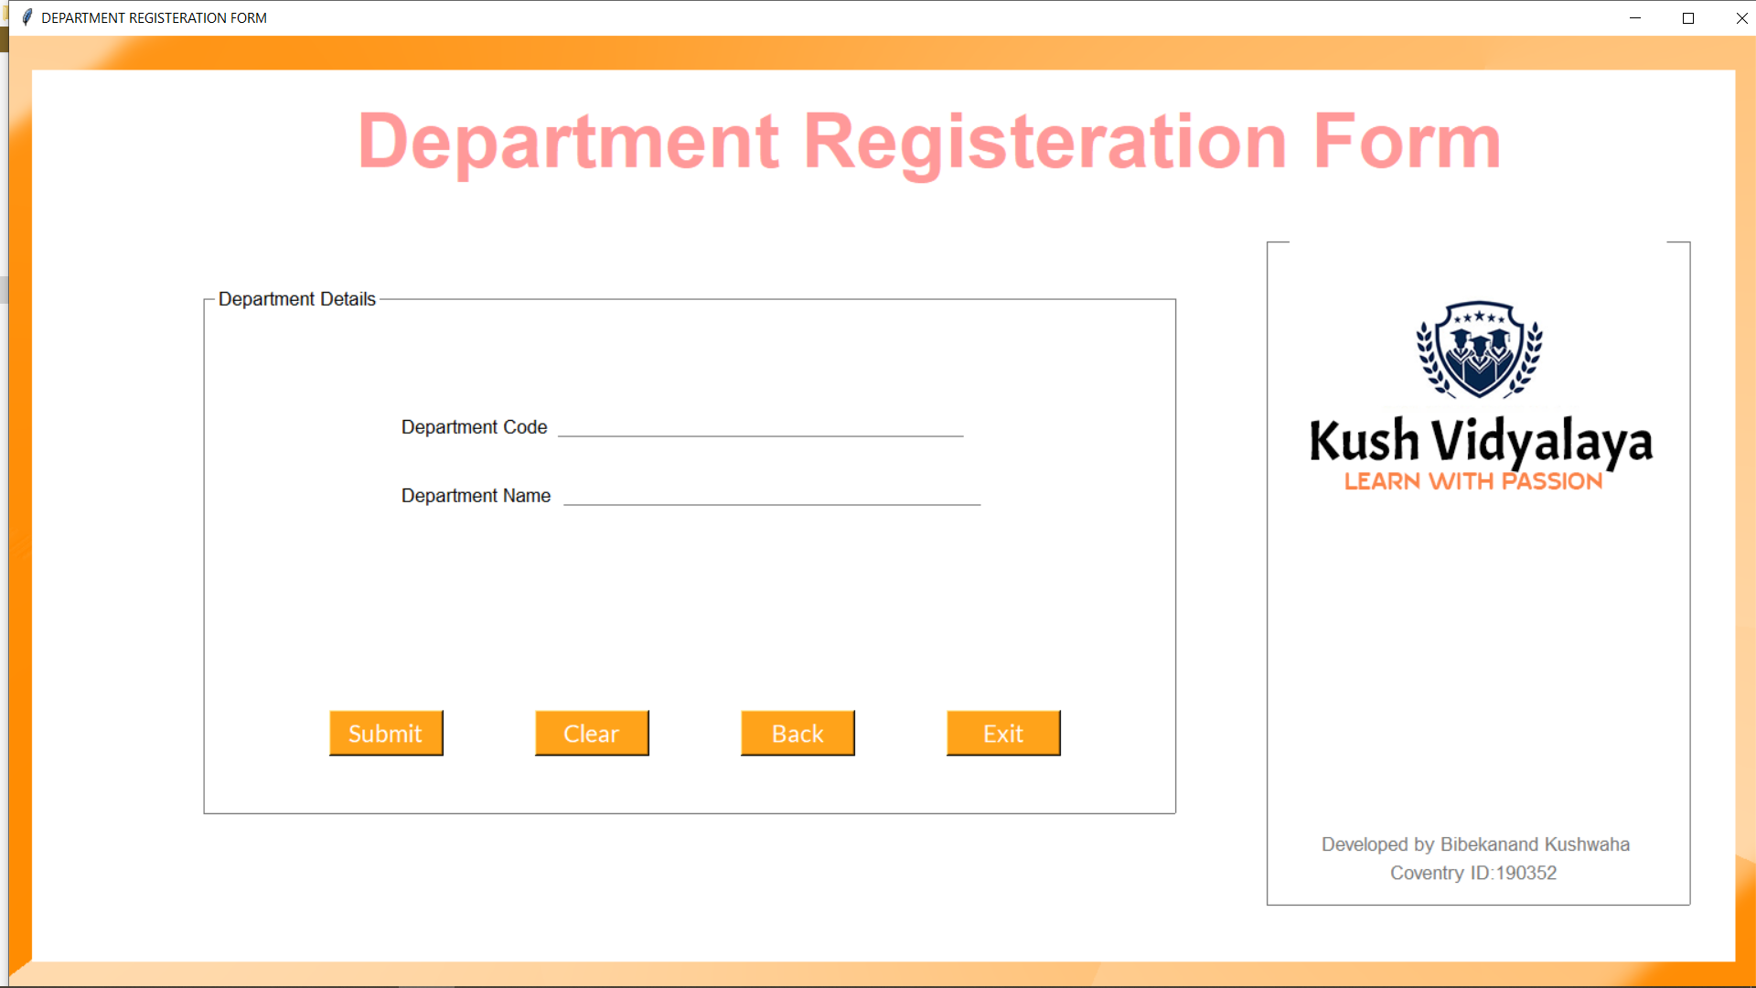
Add department
Notes:
© Copyright Showeet.com – Creative & Free PowerPoint Templates

Slide 38
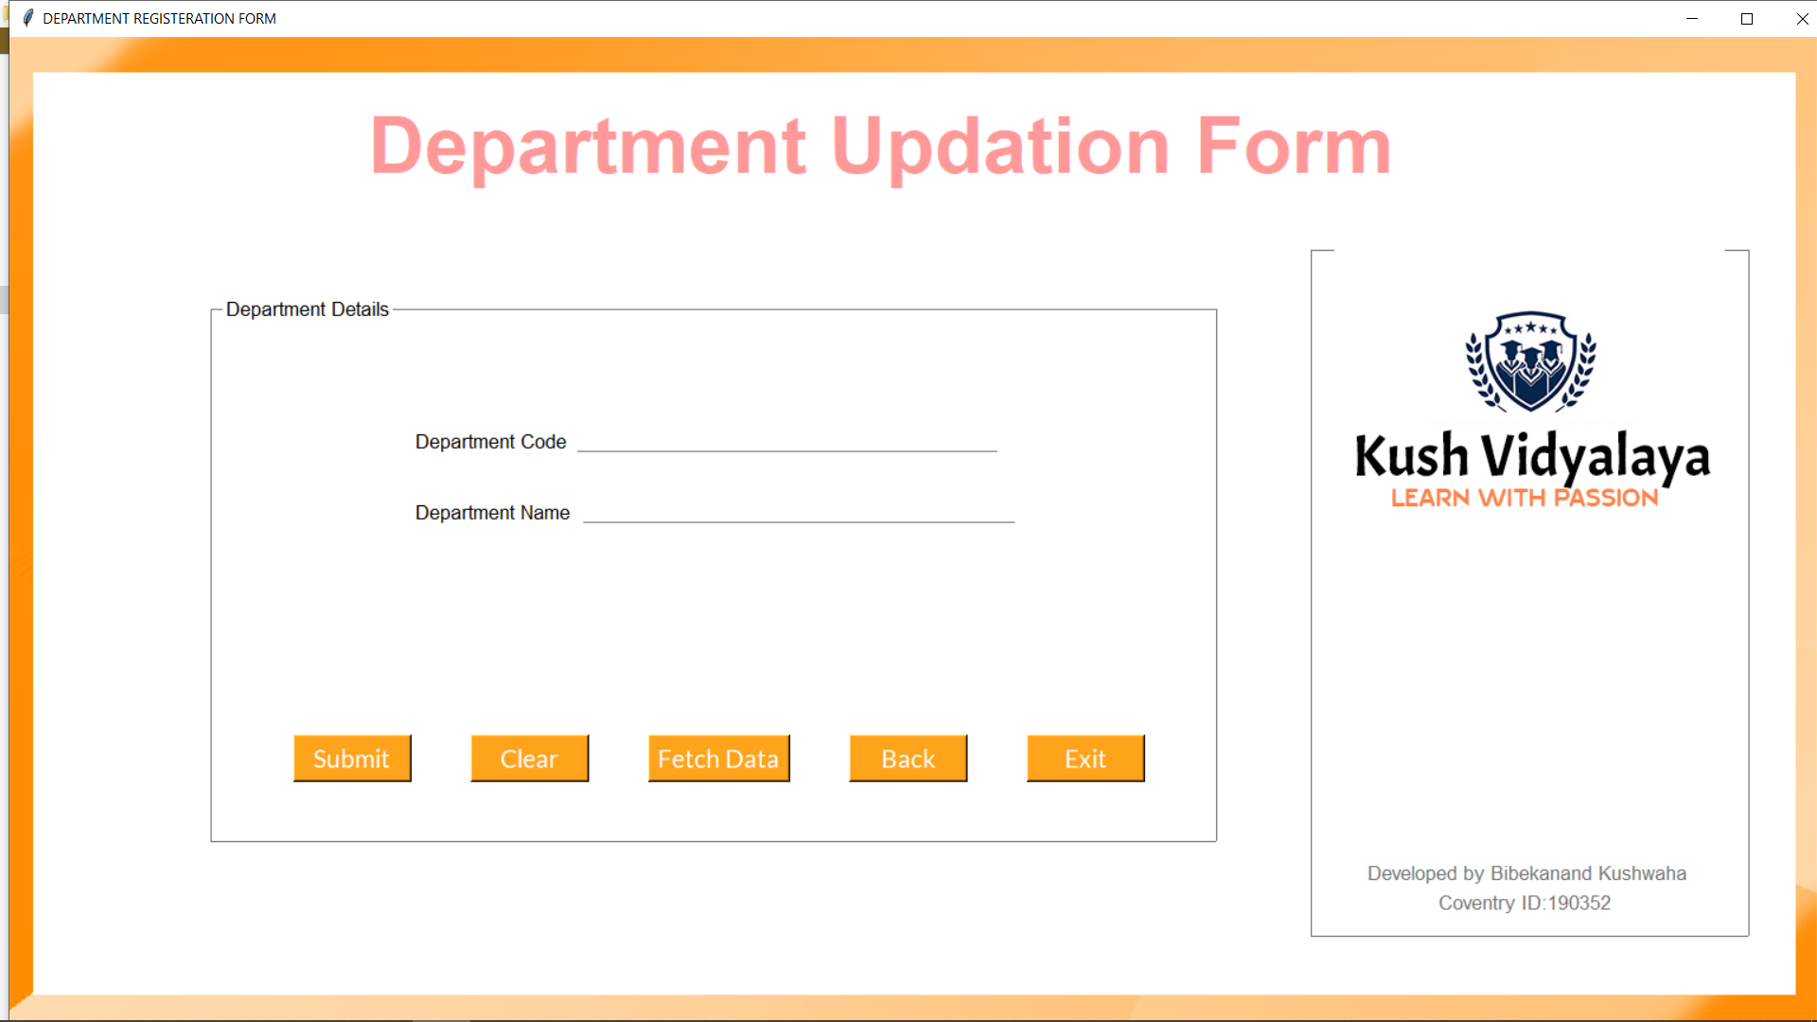
UPDATE DEPARTMENT

Slide 39
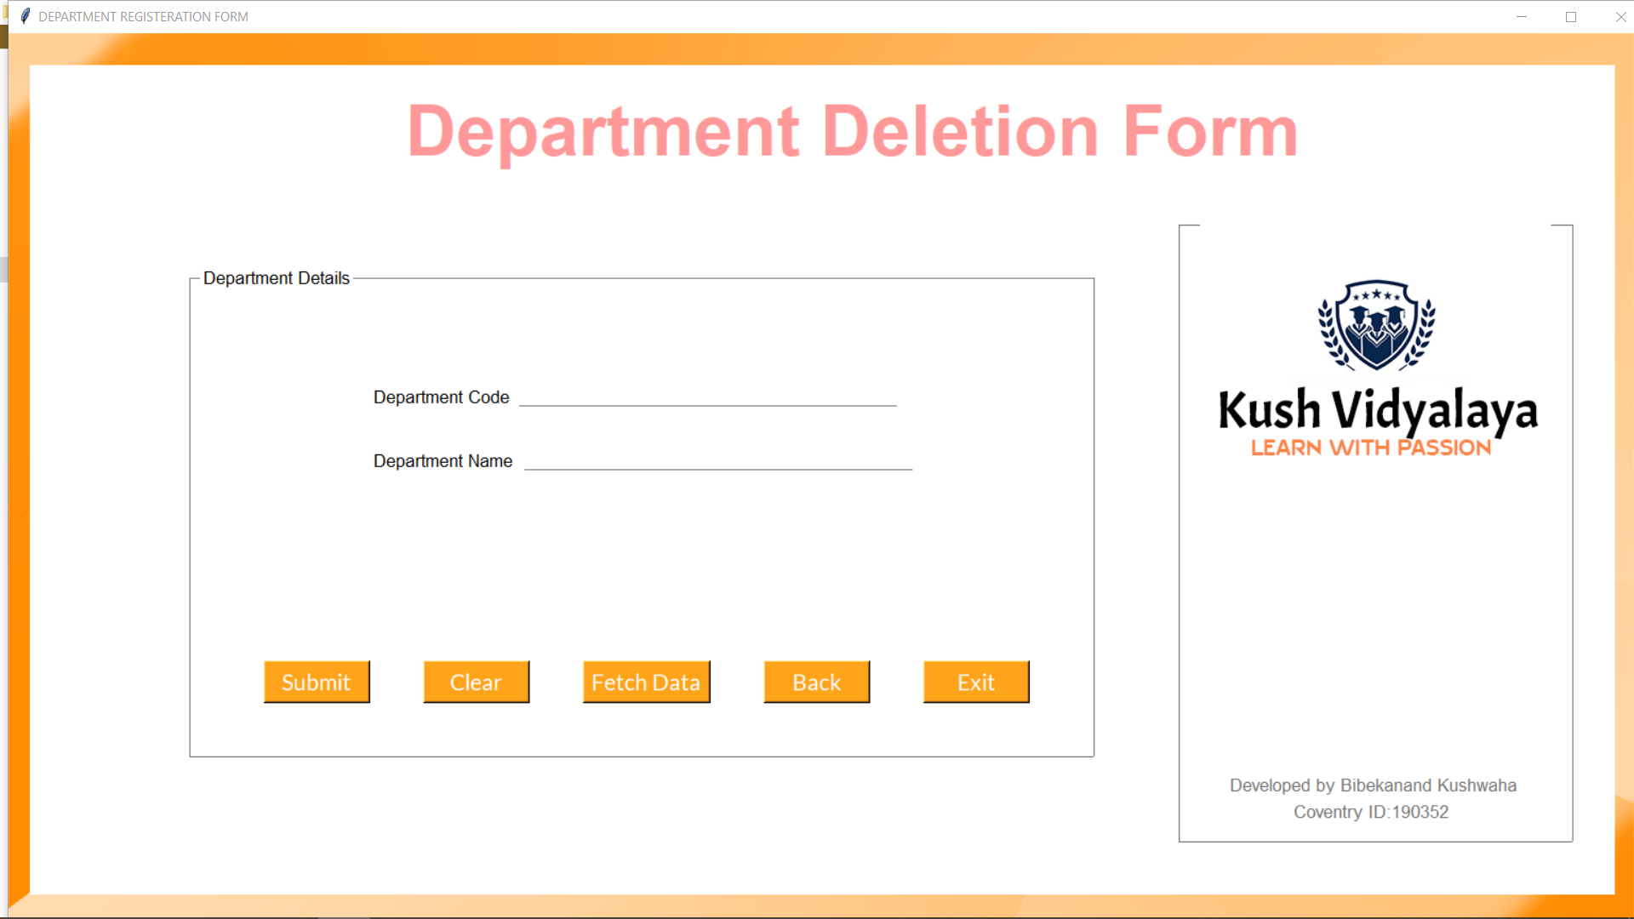
DELETE DEPARTMENT

Slide 40
COURSE DASHBOARD
Made With
Notes:
© Copyright Showeet.com – Creative & Free PowerPoint Templates

Slide 41
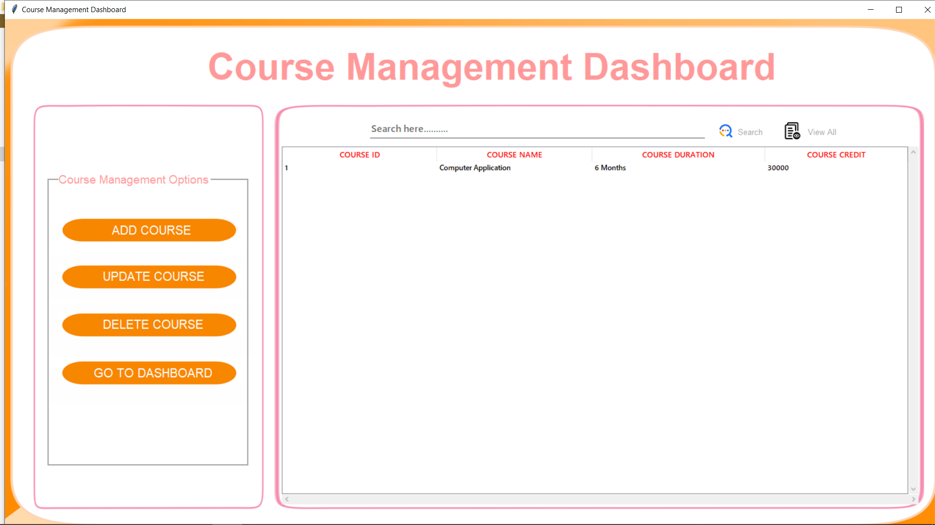
Notes:
© Copyright Showeet.com – Free PowerPoint Templates

Slide 42
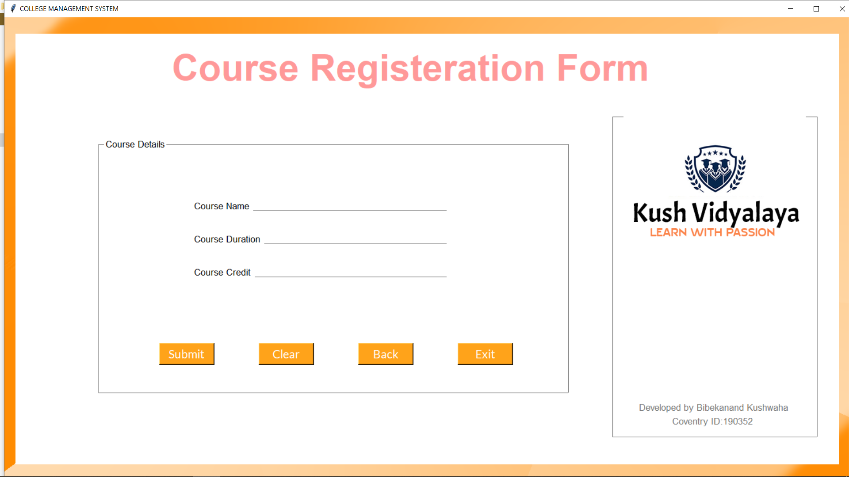
Add Course
Photo credit: ennelise via Pixabay (Creative Commons Zero license)
Notes:
© Copyright Showeet.com – Creative & Free PowerPoint Templates

Slide 43
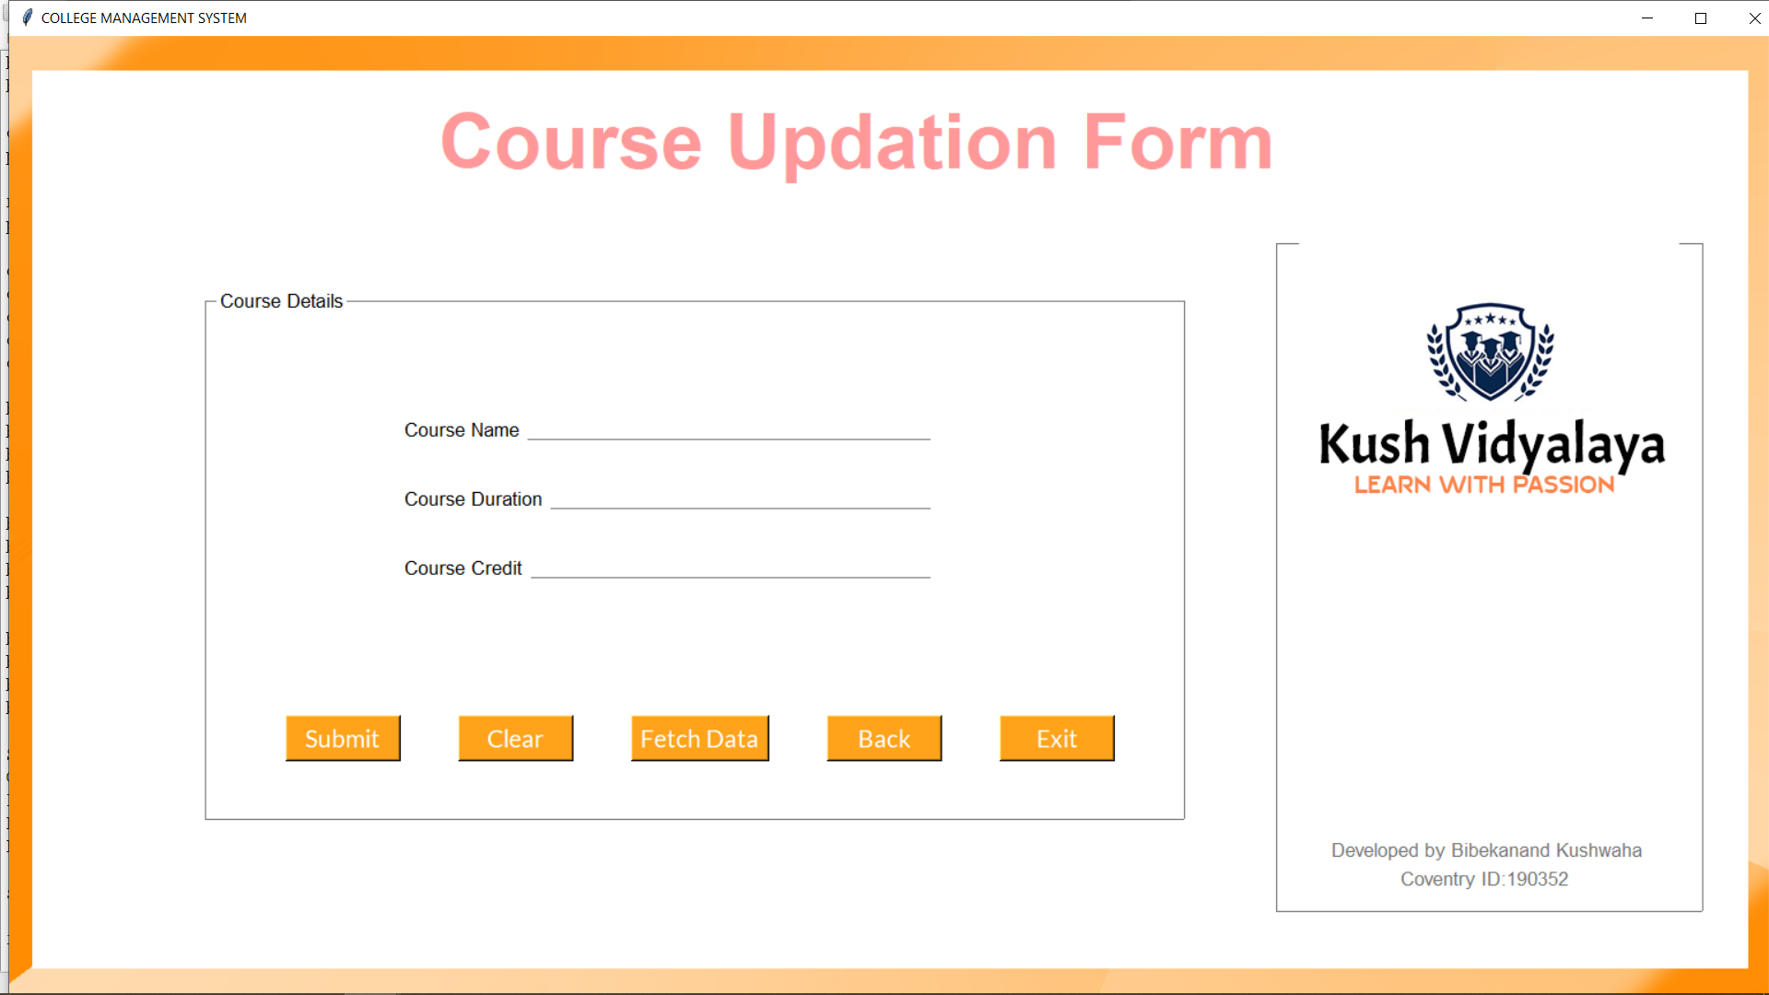
UPDATE COURSE

Slide 44
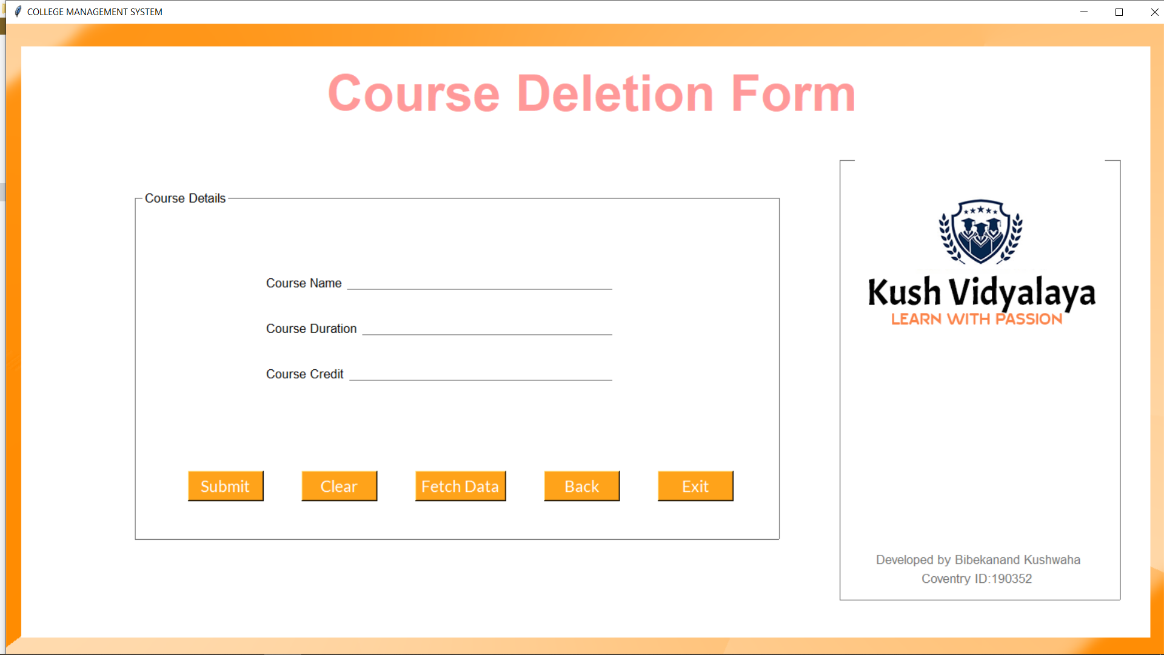
DELETE COURSE

Slide 45

SECTION DASHBOARD
View Slides
Photo credit: padrinan via Pixabay (Creative Commons Zero license)
Notes:
© Copyright Showeet.com – Creative & Free PowerPoint Templates

Slide 46
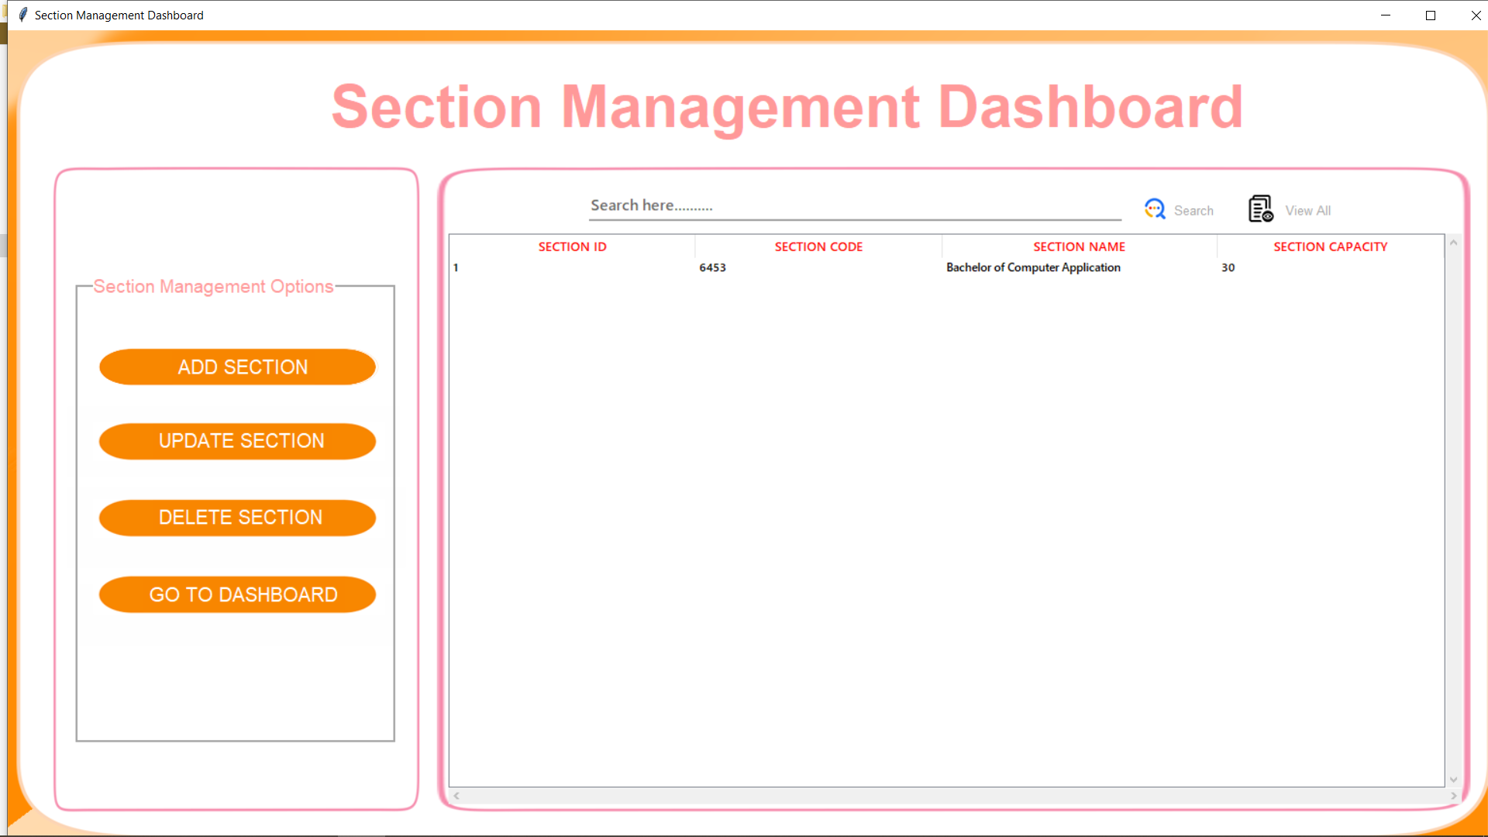
Notes:
© Copyright Showeet.com – Free PowerPoint Templates

Slide 47

Add section
Photo credit: Friis-Holst via Pixabay (Creative Commons Zero license)
Notes:
© Copyright Showeet.com – Creative & Free PowerPoint Templates

Slide 48
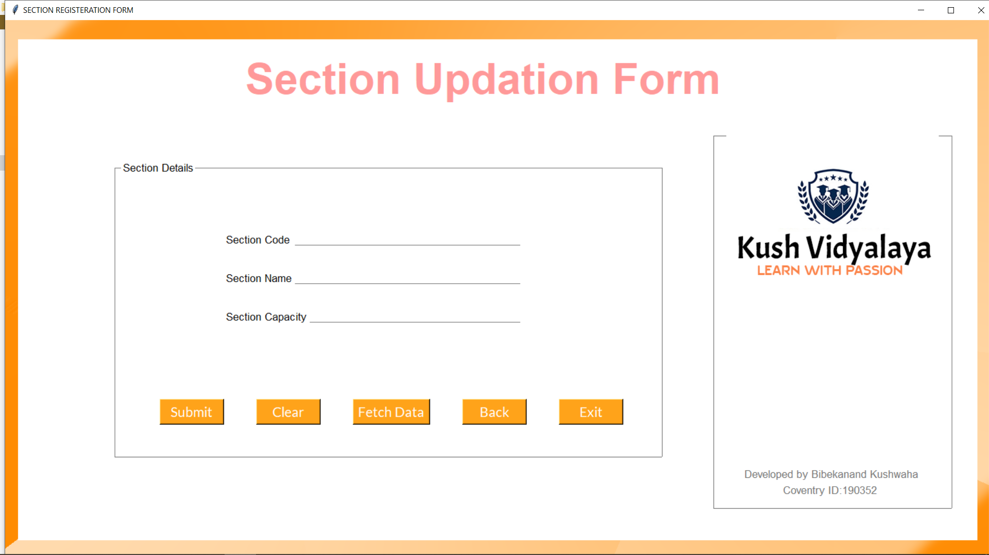
UPDATE SECTION

Slide 49
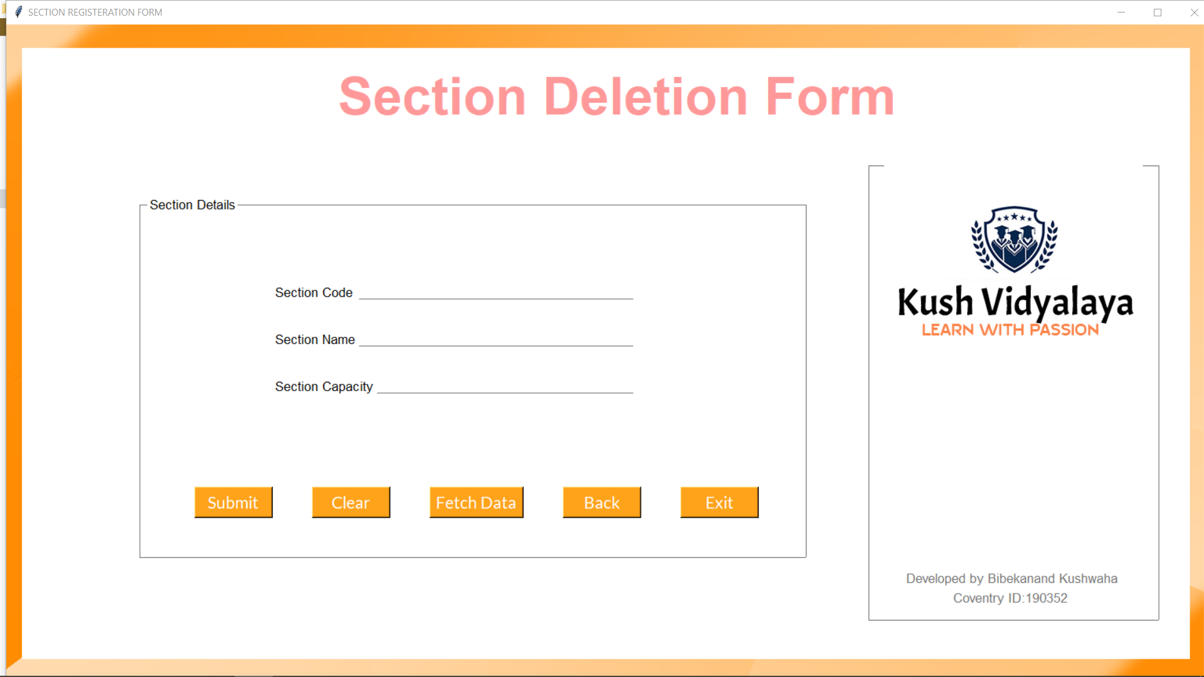
DELETE SECTION

Slide 50
BATCH DASHBOARD
Notes:
© Copyright Showeet.com – Creative & Free PowerPoint Templates

Slide 51

Notes:
© Copyright Showeet.com – Free PowerPoint Templates

Slide 52
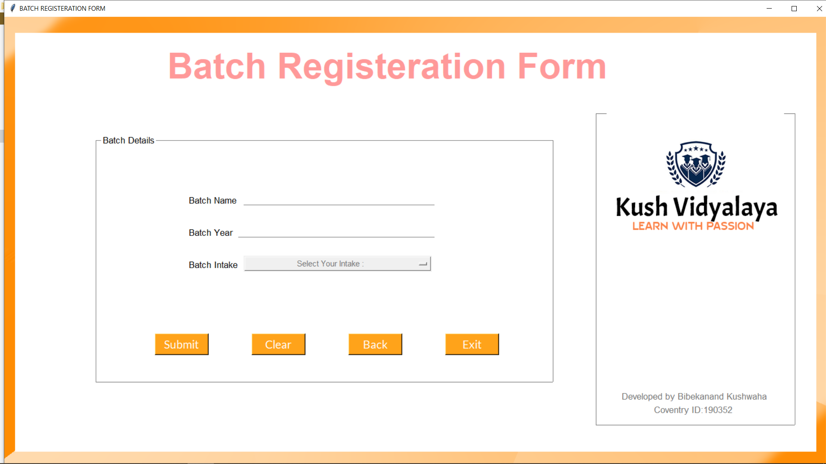
Add batch
Notes:
© Copyright Showeet.com – Creative & Free PowerPoint Templates

Slide 53
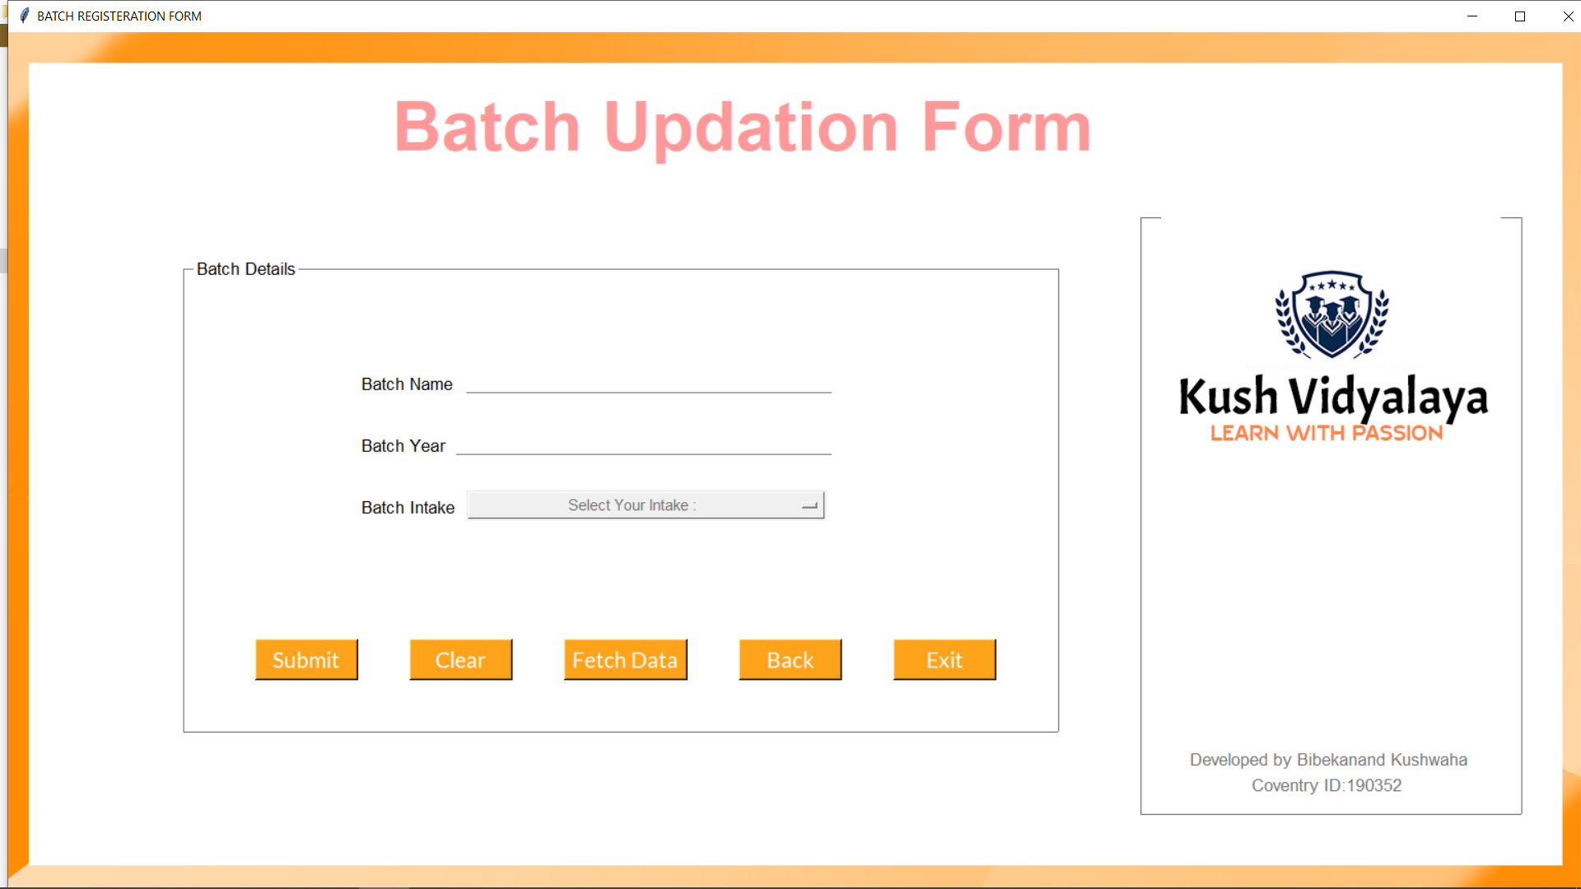
UPDATE BATCH

Slide 54
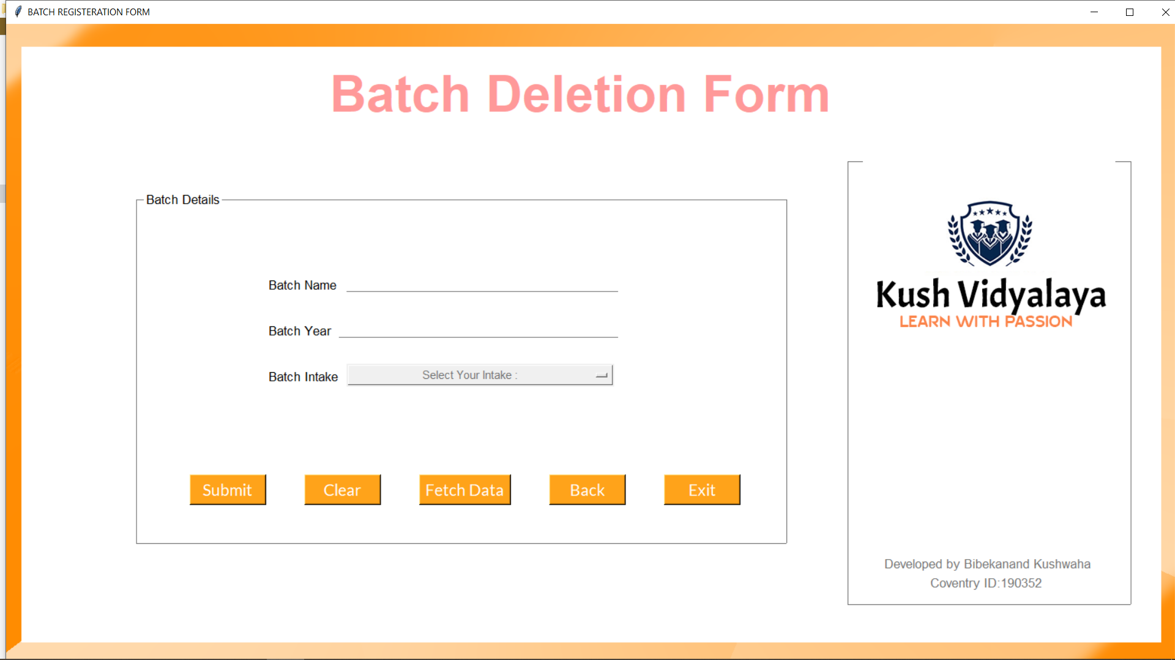
DELETE BATCH

Slide 55
VIEW INFORMATION
VIEW SLIDES
Notes:
© Copyright Showeet.com – Creative & Free PowerPoint Templates

Slide 56

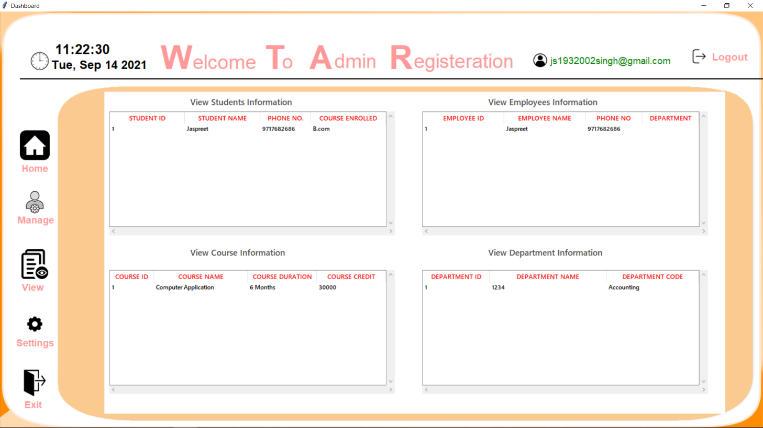
VIEW INFORMATION DASHBOARD
Notes:
© Copyright Showeet.com – Creative & Free PowerPoint Templates

Slide 57
SETTINGS
VIEW SLIDES
Notes:
© Copyright Showeet.com – Creative & Free PowerPoint Templates

Slide 58

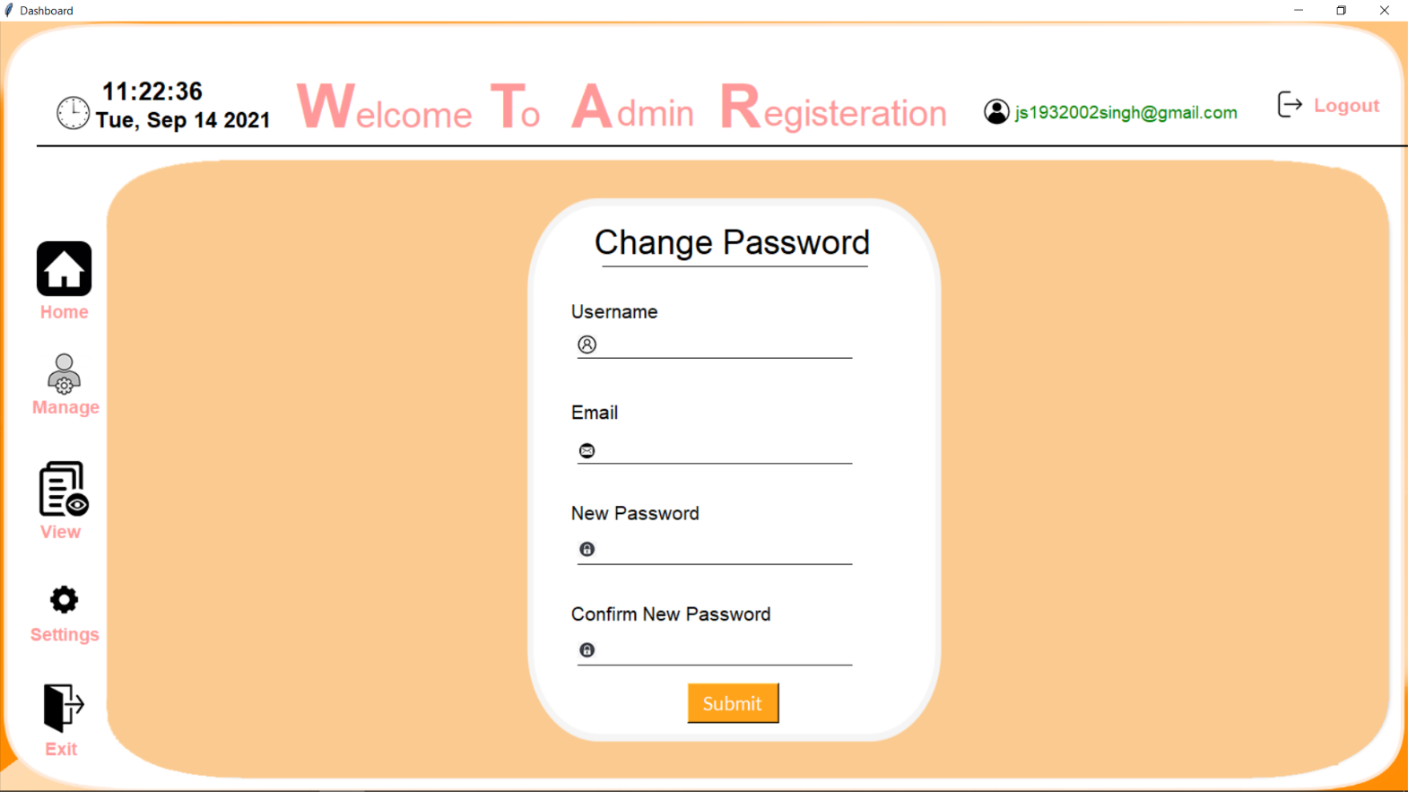

SETTINGS DASHBOARD
Notes:
© Copyright Showeet.com – Creative & Free PowerPoint Templates

Slide 59
BIG
is beautiful
So Dream “BIG”
So Dream “BIG”
Notes:
© Copyright Showeet.com – Creative & Free PowerPoint Templates

Slide 60

Hope you like this Project :)
Made With
Notes:
© Copyright Showeet.com – Creative & Free PowerPoint Templates

